Slide 1
Understanding g-causal analysis

Slide 2
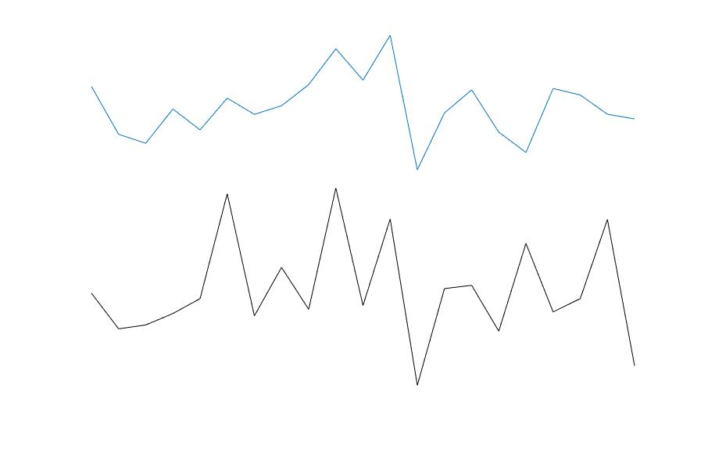
How correlated are these signals
Notes:
In the previous section we look at cross correlation – so looking at how associated the signals where at different time lags

Slide 3
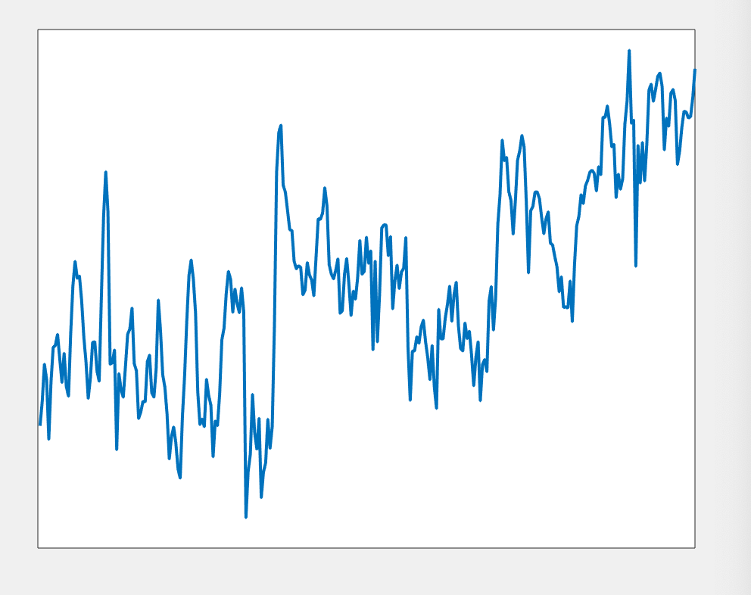
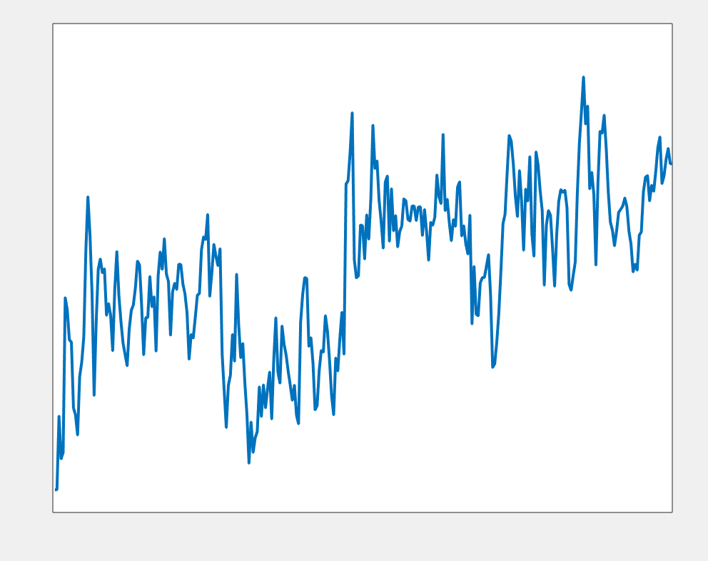
Trying to predict this
Sensor A
Including this
Including this
Sensor B

Slide 4

AR modelling of data
Univariate autoregression
$y_{t}$ = $δ+ψ\left(previous value of y\right)+randon noise \left(error\right)$
$X_{t}$ = $δ+ψ\left(previous value of x\right)+randon noise \left(error\right)$
Bivariate autoregression
$y_{t}$ = $δ+ψ\left(previous value of y\right)+ψ\left(previous value of x\right) +randon noise \left(error\right)$
Notes:
Where $δ$ is the intercept
And $ψ$ is the regression coefficient
And $ε_{t}$ is the residuals from the model fit
Which is given as $ε=y−\hat{y}$
Where $y$ is equal to the actual data and $\hat{y}$ is the model predicted data

Slide 5
Autoregressive model – how well can we model activity at sensor A using past samples of A
Trying to predict this
Sensor A
Including this

Slide 6
Are we better able to model the data in A (using regression) if we also include samples of B in the model?

Slide 7
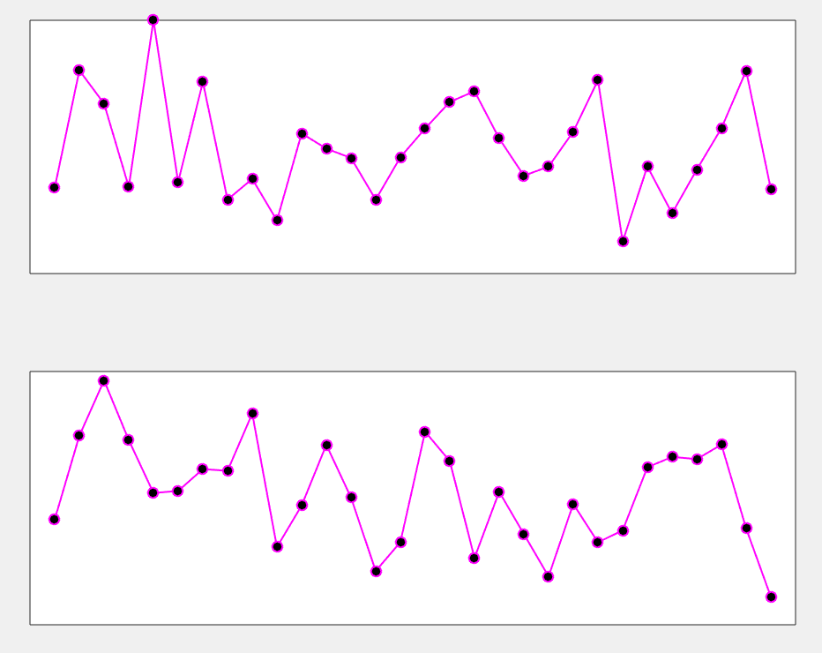
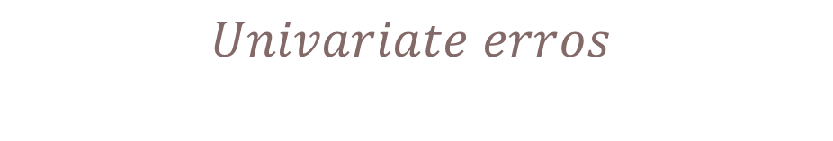
If yes – then the errors for bivariate will be smaller – as model will be a better fit
$$Univariate erros$$
$$Bivariate errors$$
Notes:
One error term per time point – imagine these are time series of error terms. Now you need to explain how granger is derived from this

Slide 8

$$GC=log \left(\frac{Var(e)}{Var(∈)}\right)$$

Slide 9
Switch over to MATLAB here

Slide 10
Model order
Things to consider:
Lower model orders require estimating less parameters and so are less sensitive to noise.
Lower models won't be sensitive to relationships that develop over larger time lags
Higher model orders can capture these relationships and can be used to look at low frequency signal dynamics.
Using longer time segments increases likelihood of non stationarity (assumption of AR modelling)

